Slide 1
Control/Branch Hazards

Slide 2
Control/Branch Hazards
Caused by a delay in the availability of an instruction or the memory address needed to fetch the instruction
In ideal pipelined execution, a new instruction is fetched every cycle, while the previous instruction is being decoded
Instruction addresses are pre-determined, PC ←[PC]+4
However, branch instructions can alter this sequence
Branch instructions needs to finish execution first
To determine whether and where to branch
Pipeline stalled before the branch outcome is known
C.2, 3.1 Pipeline hazards

Slide 3
Conditional Branches – 1
Consider a conditional branch instruction such as
Testing the branch condition (comparing [x5] and [x6]) determines whether the branch is taken or not taken
also, compute branch target address PC + loop
loop: ld f1, 0(x6)
...
BEQ x5, x6, loop
add x2, x4, x5
C.2, 3.1 Pipeline hazards
Notes:
branch instruction execution: calculate target address, and resolve branch condition
define “taken” and “non taken”

Slide 4
Conditional Branches – 2
Both comparison and target address calculation happen in EX stage (3rd cycle of instruction processing)
Stall penalty = 2 cycles
Cannot fetch the branch target before the start of 4th cycle
No useful instruction fetched in cycles 2 and 3
C.2, 3.1 Pipeline hazards

Slide 5
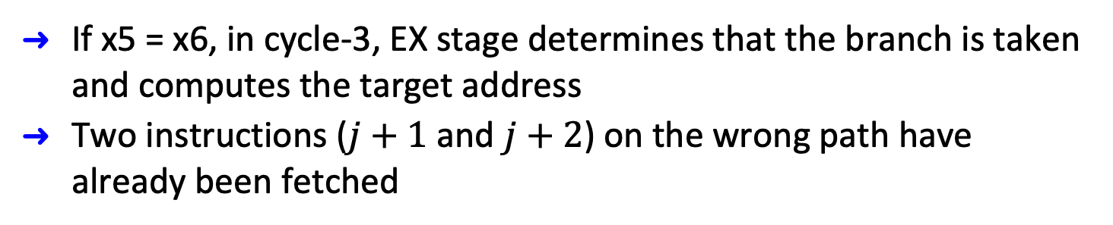

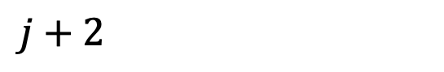
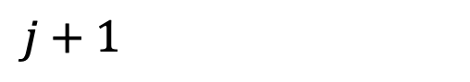
Handling Control Hazards
time
$$j$$
BEQ x5, x6, loop
$$j+1$$
$$j+2$$
If x5 = x6, in cycle-3, EX stage determines that the branch is taken and computes the target address
Two instructions ($j+1$ and $j+2$) on the wrong path have already been fetched
C.2, 3.1 Pipeline hazards

Slide 6
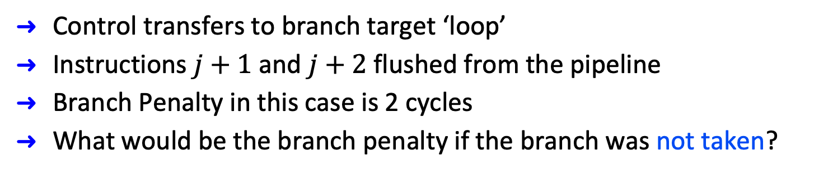
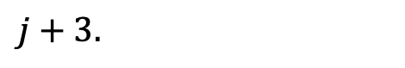
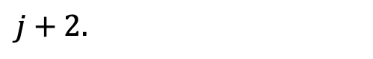
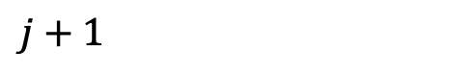
Handling Control Hazards
j: BEQ x5, x6, loop
$$j+1$$
$j+2.$
$j+3.$
Control transfers to branch target ‘loop’
Instructions $j+1$ and $j+2$ flushed from the pipeline
Branch Penalty in this case is 2 cycles
What would be the branch penalty if the branch was not taken?
C.2, 3.1 Pipeline hazards

Slide 7
Reduce Branch Penalty
Finish branches in ID stage
Compute the branch target address in the ID stage
Need an adder in the ID stage to add the branch offset to the PC
Test the branch condition in the ID stage
Move the comparator from EX stage to ID stage
Branch condition tested in parallel with target address computation
Update the PC before the end of ID stage
Branch penalty reduced to one cycle
Negative Effect: higher ID stage delay; may have to increase the clock period
C.2, 3.1 Pipeline hazards

Slide 8
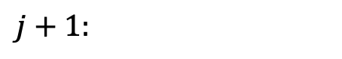
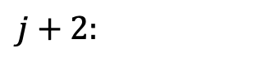
Reduce Branch Penalty
j: BEQ x5, x6, loop
$$j+1:$$
$j+2:$
Branch condition and target address computed in cycle # 2
Branch penalty reduced to one cycle
Only one instruction ( j+1 ) is fetched incorrectly and discarded
C.2, 3.1 Pipeline hazards

Slide 9
Reducing Branch Penalty – Branch Prediction
Predict-not-taken
Increment PC by 4 every cycle and keep fetching sequential instructions after the branch instruction
After the branch outcome is computed
If the branch is actually Not-taken
We have already been fetching instructions from the correct path => no problem
But if the branch is actually Taken
Need to start fetching from the branch target
What happens to the instructions that have already been fetched on the wrong path?
C.2, 3.1 Pipeline hazards

Slide 10
Reducing Branch Penalty
Predict-not-taken
C.2, 3.1 Pipeline hazards

Slide 11
Reduce Branch Penalty – Branch Prediction
Predict-taken: assume every branch as taken
In our 5-stage pipeline, we do not know branch target earlier than branch outcome
No advantage, unless we could predict the target address earlier in the pipeline
Delayed Branch (not discussed further)
Compiler optimization
Use knowledge of the program semantics to rearrange instructions before/after the branch
Useful for short pipeline – no longer used in RISC-V
C.2, 3.1 Pipeline hazards

Slide 12
Delayed Branch
Branch instruction
Sequential successor - in branch delay slot
Branch target if taken
C.2, 3.1 Pipeline hazards

Slide 13
Example
SD x7, 0(x8)
BEQ x5, x6, IF
LD x2, 16(x1)
DADD x3, x4, x2
IF: LD x2, 64(x1)
DSUB x3, x4, x2
Branch hazards?
How much is branch penalty?
Data hazards?
C.2, 3.1 Pipeline hazards
Notes:
What instruction in the sequence can be move between BEQ and LD?
move SD as it is independent of the other instructions.

Slide 14
Performance of Branch Schemes
C.2, 3.1 Pipeline hazards

Slide 15
Performance of Branch Schemes - Example
Branches comprise 20% (BF) of all instructions. Branch prediction is 80% accurate (BPA). 2 cycle stalls (SP) on each mis-prediction. Compute average branch penalty control hazards on CPI of the pipelined processor.
CPI without control hazards = 1
Stall cycles = BF* (1 – BPA) * SP = 20% * (1 - 80%) * 2 = 0.08
CPI with branch penalty = 1 + 0.08 = 1.08
C.2, 3.1 Pipeline hazards

Slide 16
Another Example
Speedup of “predicted-not-taken” over “stall pipeline” = 1.56 / 1.38 = 1.13
C.2, 3.1 Pipeline hazards
Notes:
Starting question: what are approaches to handling branch hazards?
This example shows their benefits

Slide 17
Branch Prediction
Static Prediction – high misprediction rate
Prediction for branches is fixed at taken or not-taken
Based on profile information
Dynamic Prediction
Use runtime history of branches to predict outcome of current branch
Better performance for various programs
Higher HW complexity
C.2, 3.1 Pipeline hazards
Notes:
Hypothesis: a branch (taken or not-taken) will likely repeat the same decision next time.
This is true for branches involved in loops. --- a type of temporal locality
Low order bits of branch instruction addresses are used to index Branch-prediction buffer (BPB)

Slide 18
1-Bit Predictor
Predict Not Taken
T
NT
Predict
Taken
NT
1 bit predictor - remember last taken/not taken per branch
Use part of the PC (low-order bits) to index buffer/table – multiple branches may share the same bit
Invert the bit if the prediction is wrong
T
NT
T
K-bit
Branch
address
T
NT
2^{k}
T
T
T
Prediction
NT
T
NT
C.2, 3.1 Pipeline hazards
NT
Notes:
What about PCs of two branches having the same lower bits?

Slide 19
Branch History Table (BHT)
Also called Branch Prediction Buffer (BPB)
Each entry implements 1-bit predictor – low accuracy
BHT indexed by bits from PC
Similar to direct mapped cache
More entries, more cost, but less conflicts, higher accuracy
Backward branches for loops will be mis-predicted twice
Once upon loop exit and then again on loop entry
More complex predictors for better prediction
C.2, 3.1 Pipeline hazards
What about PCs of two branches having the same lower bits?

Slide 20
1-Bit Predictor
Consider a loop of 9 iterations before exit:
First time through inner loop, predicts exit instead of looping
End of inner loop, predict looping instead of exiting
Mis-predict twice every time the inner loop is executed
outer: for (…) {
inner: for (i=0; i<9; i++)
a[i] = a[i] * 2.0;
}
C.2, 3.1 Pipeline hazards

Slide 21
2-Bit Predictor
Optimization: 2-bit scheme where change prediction only if get mis-prediction twice consecutively
Other solutions: correlating predictor, tournament predictors
C.2, 3.1 Pipeline hazards

Slide 22
2-Bit Predictor Accuracy
BHT: 4096 entry 2-bit buffer
FP programs
Integer
programs
C.2, 3.1 Pipeline hazards

Slide 23
Impact of BHT Size
4K vs Unlimited Buffer for Prediction
C.2, 3.1 Pipeline hazards

Slide 24
Correlating Branch Predictors
addi x3, x1, –2
bnez x3, L1 // branch b1 (aa!=2)
add x1, x0, x0 //aa=0
L1: addi x3, x2, –2
bnez x3, L2 // branch b2 (bb!=2)
add x2, x0, x0 //bb=0
L2: sub x3, x1, x2 //x3=aa-bb
beqz x3, L3 // branch b3 (aa==bb)
If (aa == 2)
aa = 0;
If (bb == 2)
bb = 0;
If (aa != bb) {…}
If both b1 and b2 are not taken, then b3 is taken.
Use history of last m branches to predict the current one.
3.3 Advanced Branch Prediction
Notes:
branches are often correlated
branch b3 is correlated to b1 and b2.

Slide 25
Correlating Branch Predictors
Use history of last m branches to predict the current branch.
Each predictor uses n bits.
BHT
<-- n-bit -->
Global history register
of last m branches
t | nt | t | t | nt
2^{m} entries
Shift register
t – taken
nt – not taken
3.3 Advanced Branch Prediction
n-bits
Notes:
Benefit: higher prediction accuracy, low HW overhead.

Slide 26
Correlating Branch Predictors
Use additional k-bits of branch instruction address for better correlation
Branch prediction buffer
(2^{m+k} entries, each of n-bits)
<-- n-bit -->
Global history register
of last m branches
m+k
Shift register
t | nt | t | t | nt
2^{m+k} entries
Low order k-bits
of branch address
3.3 Advanced Branch Prediction
n-bits
Notes:
Using k-low order address bits of the current branch instruction to reduce interferences among different branch instructions.

Slide 27
Tournament Predictors
Tournament predictor selects the best of local and global predictors, and leads to better prediction.
3.3 Advanced Branch Prediction

Slide 28
Summary—Dependences & Hazards
Structural dependence, s-hazard
Duplicate hardware
Data dependence, RAW/WAR/WAW hazards
forwarding
out-of-order execution -- to be discussed later
Control/branch dependence, branch hazard
branch prediction
hardware speculation – to be discussed later

